Slide 1

Fayllar bilan ishlash

Slide 2
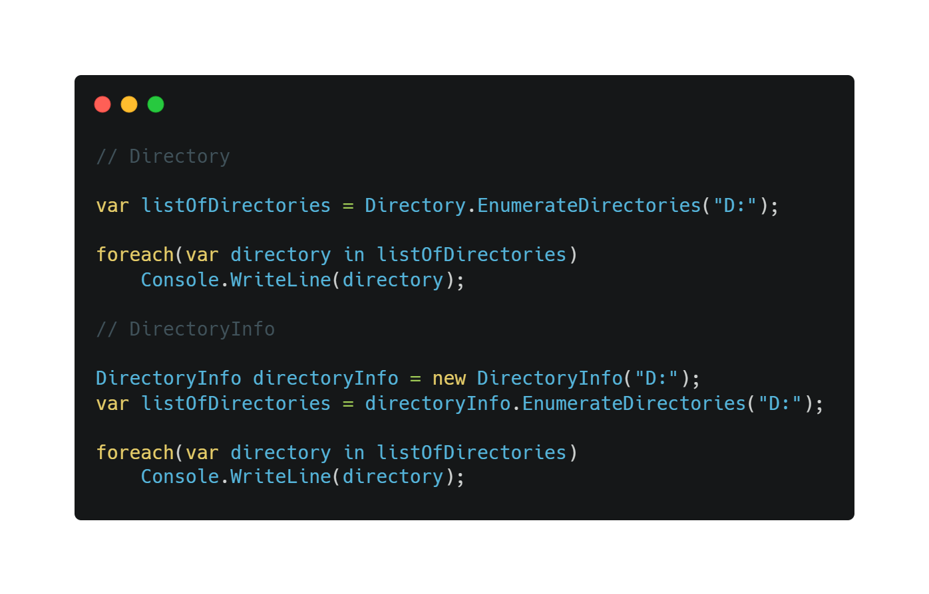
Directory va DirectoryInfo

Slide 3
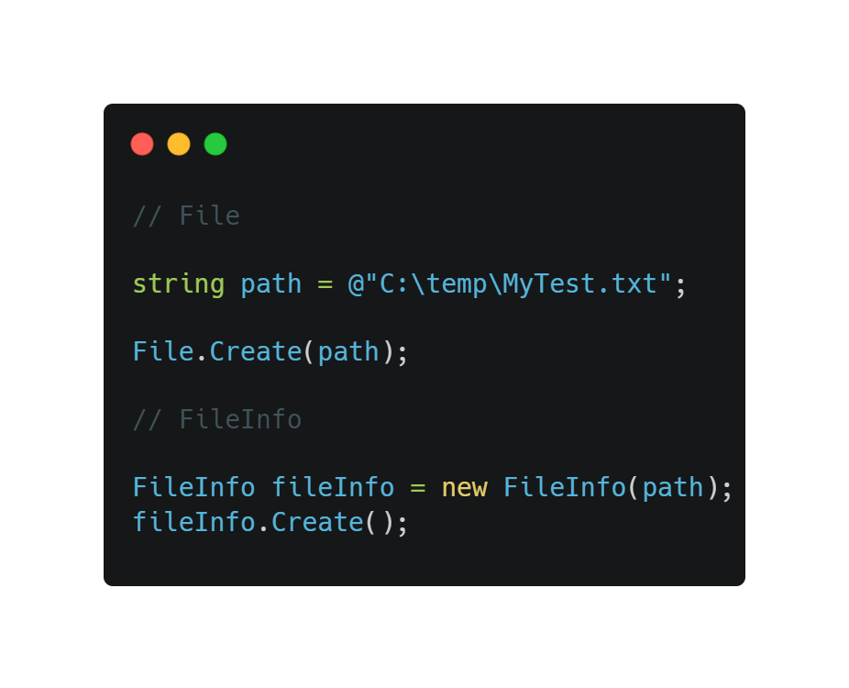
File va FileInfo

Slide 4
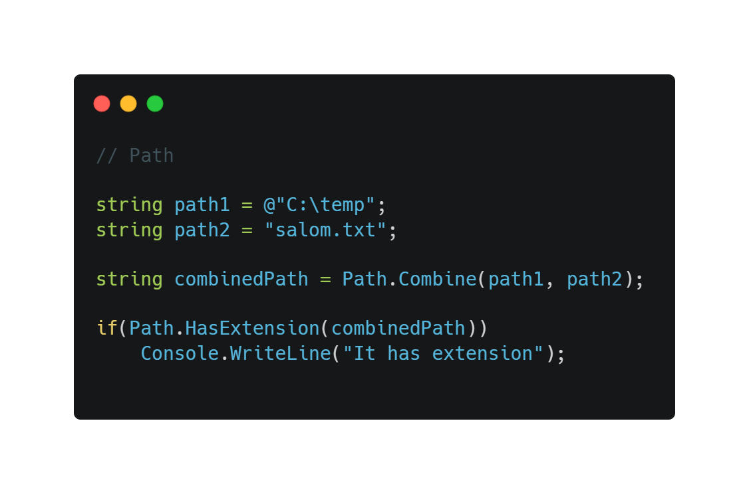
Path

Slide 5
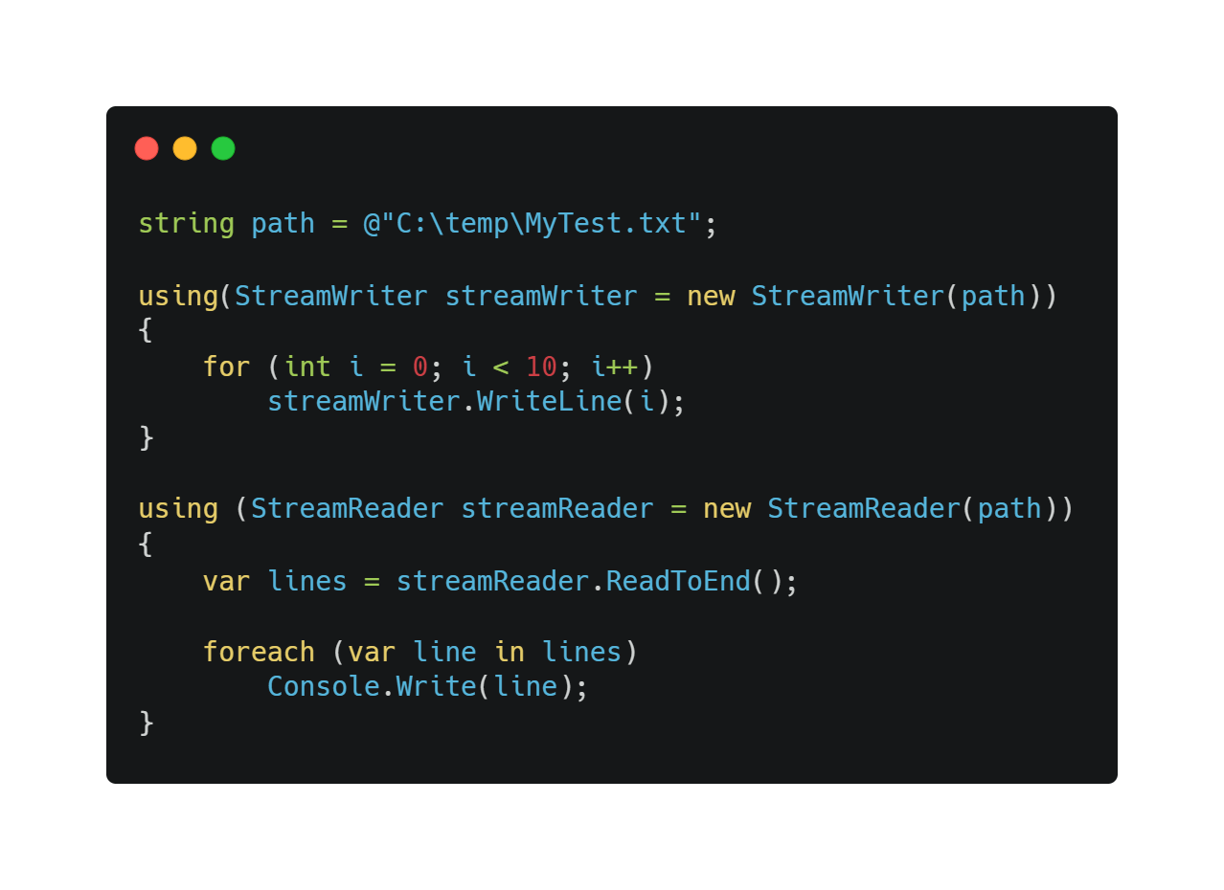
StreamWriter va StreamReader

